Slide 1
UML
The Unified Modeling Language (UML) is a graphical language for OOAD that gives a standard way to write a software system’s blueprint. It helps to visualize, specify, construct, and document the artifacts of an object-oriented system. It is used to depict the structures and the relationships in a complex system.
There are 2 basic kinds of UML Diagram, namely −
Structure Diagrams(How the system does it /Technical)
Class Diagram
Component Diagram
Deployment Diagram
Object Diagram
Package Diagram
Behavioral Diagrams (What the system does/Functional)
Use Case Diagram
Activity Diagram
State Machine Diagram
Sequence Diagram
Timing Diagram

Slide 2
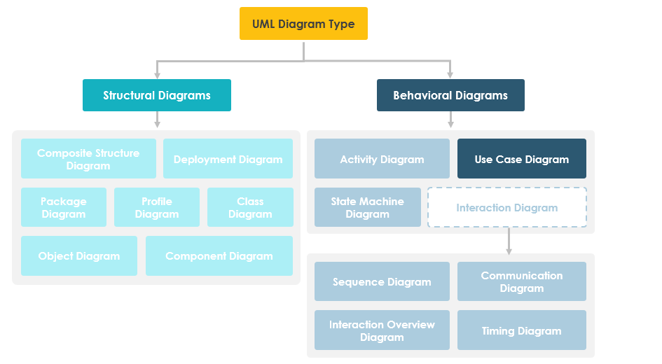

Slide 3
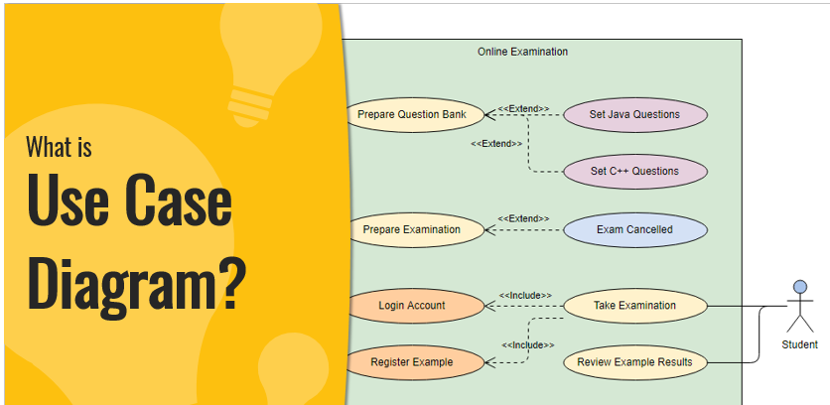

Slide 4
What is a use case diagram?
Why Use case diagram?
Why use cases?.

Slide 5
Use cases specify the expected behavior (what), and not the exact method of making it happen (how).
Use cases once specified can be denoted both textual and visual representation (i.e. use case diagram).
A key concept of use case modeling is that it helps us design a system from the end user's perspective.
It is an effective technique for communicating system behavior in the user's terms by specifying all externally visible system behavior.
A use case diagram is usually simple. It does not show the detail of the use cases:
It only summarizes some of the relationships between use cases, actors, and systems.
It does not show the order in which steps are performed to achieve the goals of each use case.

Slide 6
Origin of Use Case
These days use case modeling is often associated with UML, although it has been introduced before UML existed. Its brief history is as follow:
In 1986, Ivar Jacobson first formulated textual and visual modeling techniques for specifying use cases.
In 1992 his co-authored book Object-Oriented Software Engineering - A Use Case Driven Approach helped to popularize the technique for capturing functional requirements, especially in software development.

Slide 7

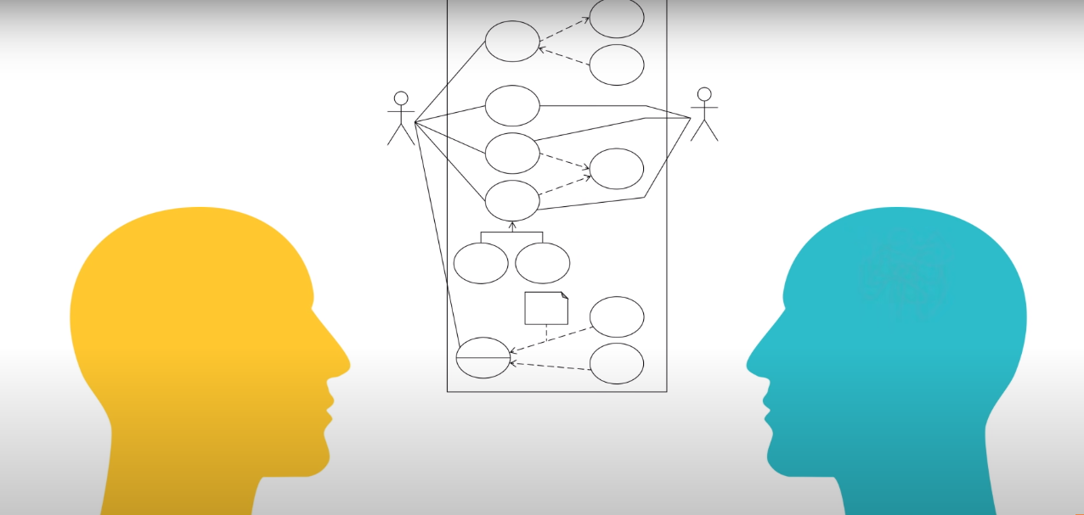
Use case diagram
To model a system, the most important aspect is to capture the dynamic behavior. Dynamic behavior means the behavior of the system when it is running/operating.
Use case diagrams are considered for high level requirement analysis of a system. When the requirements of a system are analyzed, the functionalities are captured in use cases

Slide 8
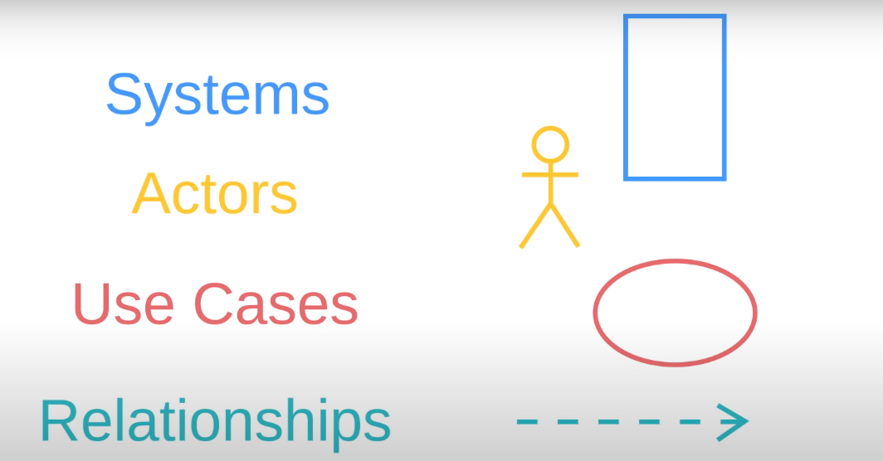
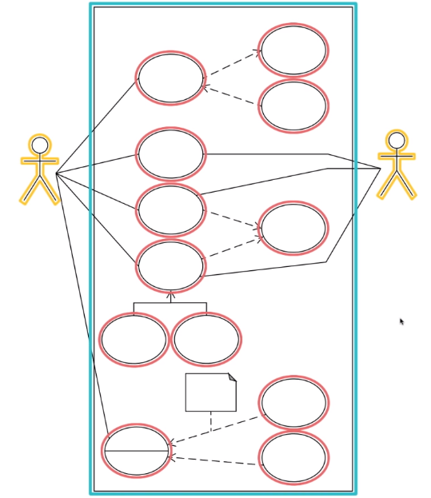
Use case Diagram
Components of Use case diagram.

Slide 9
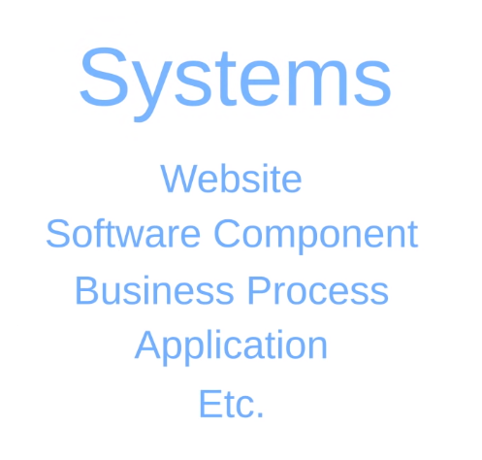

Slide 10
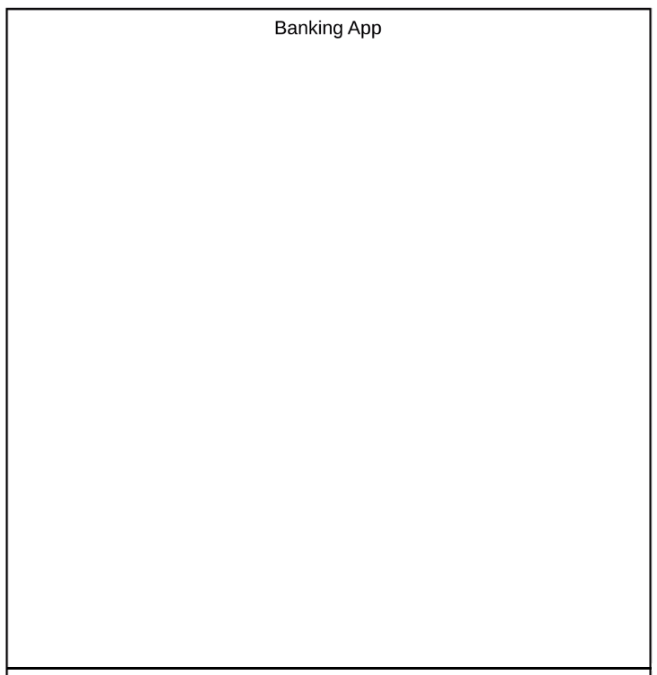
System is represented by a rectangle and name of system is put at the top
Anything within this rectangle happens within the Banking App.
Anything outside this rectangle doesn’t happen in the Banking
App.

Slide 11
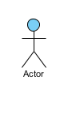
Actor
Someone interacts with use case (system function).
Named by noun.
Actor plays a role in the business
Similar to the concept of user, but a user can play different roles
Actor triggers use case(s).
Actor has a responsibility toward the system (inputs), and Actor has expectations from the system (outputs).
Actors are always outside the system and interact directly with it by initiating a use case, provide input to it, and/or receive outputs from it.

Slide 12
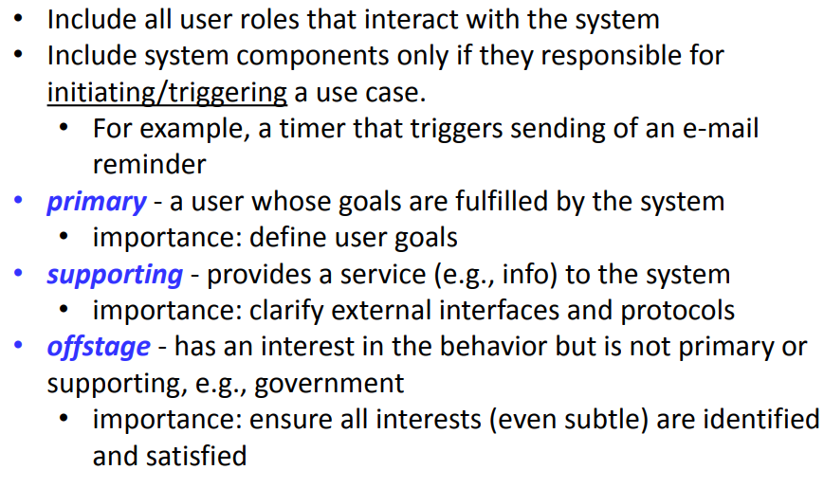
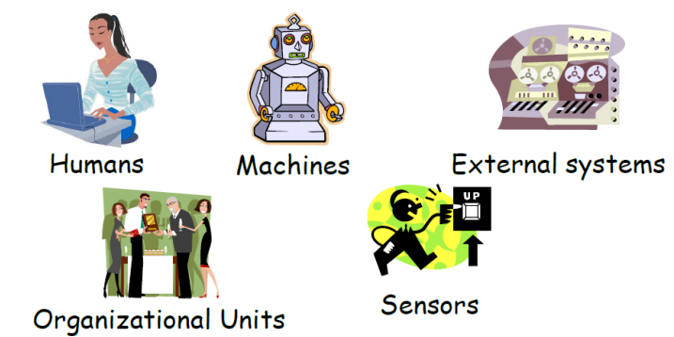
Actor

Slide 13
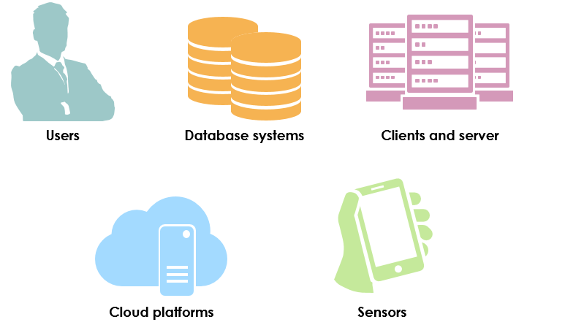
Types of actors include:
Users
database systems
clients and servers
cloud platforms
devices

Slide 14
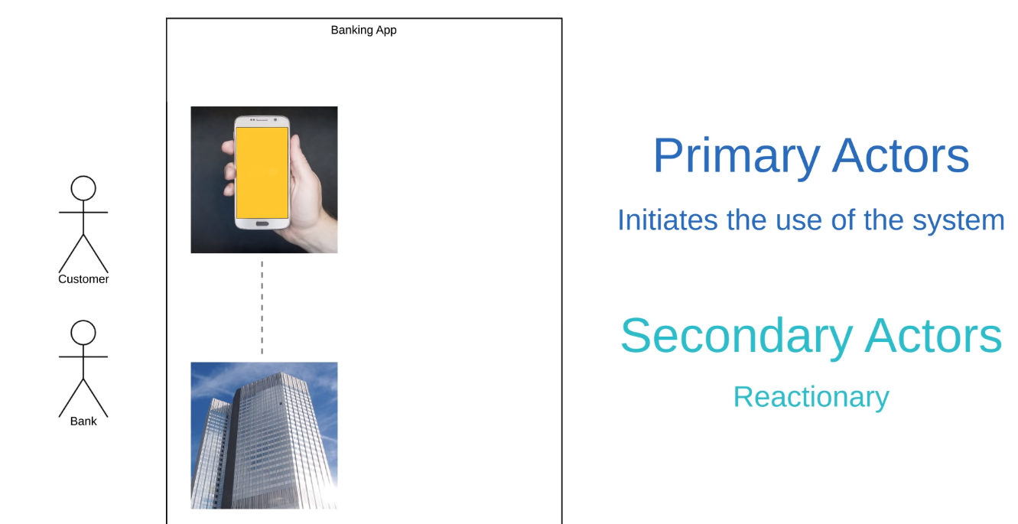
First, it’s important to note that these actors are external objects. They always need to be placed outside of our system.
Keep things categorical
Right now we’re saying that both Customers and Banks are going to use our app.

Slide 15
Identify the actors
A user clicks the search button on an application’s user interface. The application sends an SQL query to a database system. The database system responds with a result set. The application formats and displays the result set to the user.

Slide 16
In this scenario:
The user is a primary actor because he initiates the interaction with the system (application).
The database system is a secondary actor because the application initiates the interaction by sending an SQL query.
Once you have identified your actors and their goals, you have now created your initial list of high-level use cases. Remember, effective use cases must have understandable actors and goals.

Slide 17
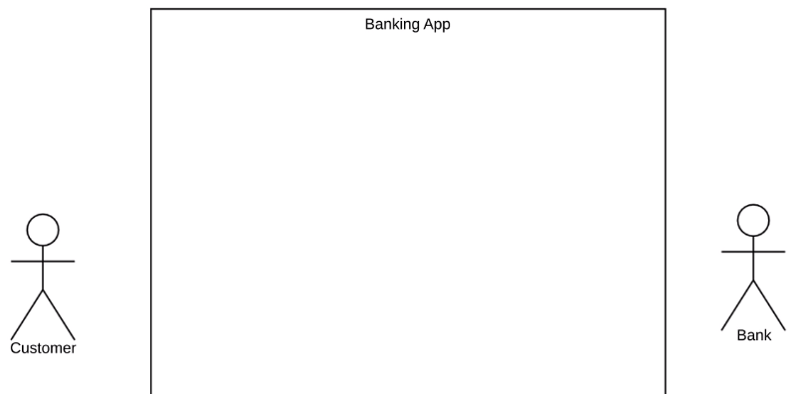
Primary actors should be to the left of the system, and secondary actors should be to on the right.
This just visually reinforces the fact that Customer engages with the Banking App and then the Bank reacts

Slide 18
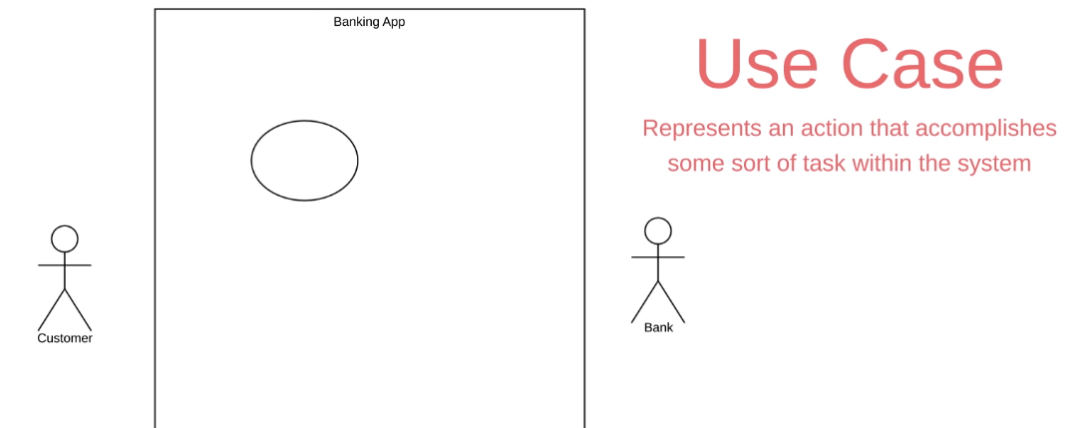
Use Case
The next element is a Use Case and this is where you really start to describe what your
system does.
A Use Case is depicted with this oval shape and it represents an action that accomplishes
some sort of task within the system
They’re going to be placed within the rectangle because they’re actions that occur within
the Banking App.

Slide 19
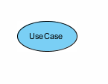
System function (process - automated or manual)
Named by verb + Noun (or Noun Phrase).
i.e. Do something
Each Actor must be linked to a use case, while some use cases may not be linked to actors.

Slide 20
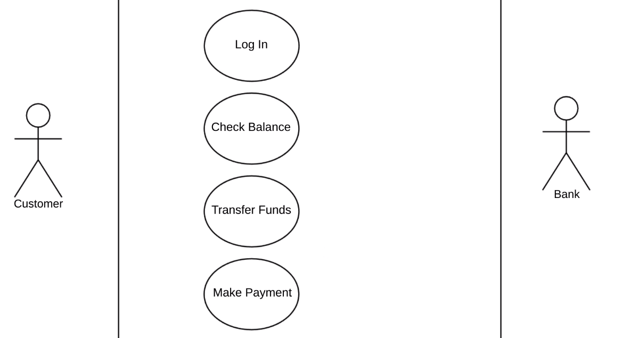
It’s good practice to put your Use Cases in a logical order when possible.

Slide 21
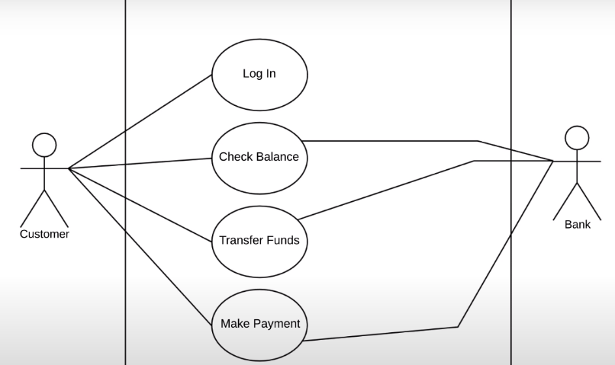
Relationship
In this example, a Customer is going to Log In to our Banking App.
So we draw a solid line between the Actor and the Use Case to show this relationship.
This type of relationship is called an association and it just signifies a basic communication or interaction

Slide 22
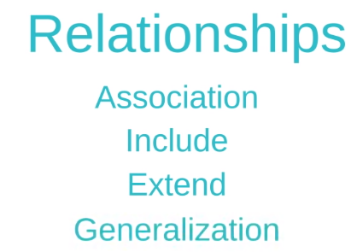

Slide 23
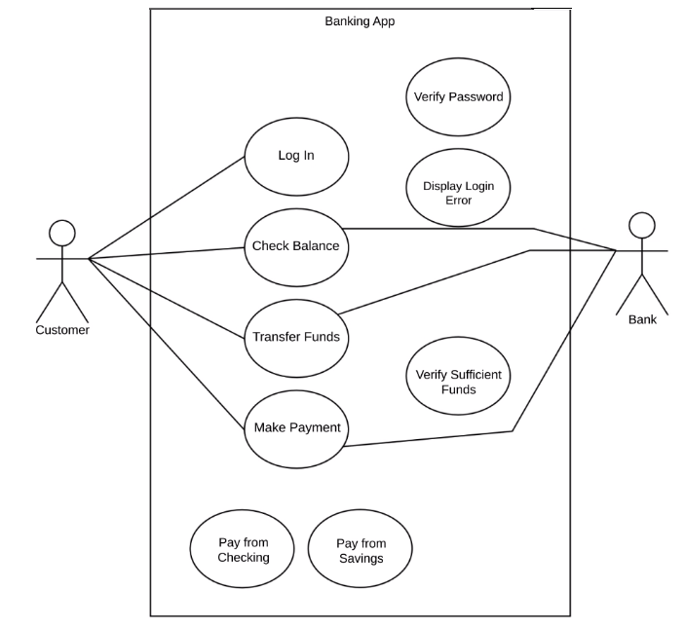

Slide 24
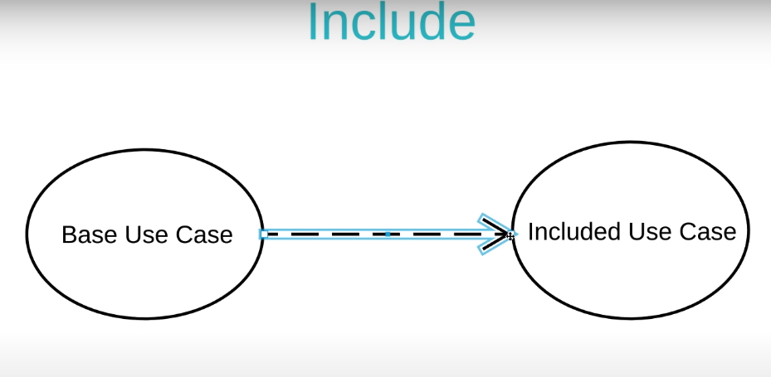
An Include relationship shows dependency between a base use case and an included use case.
Every time the base use case is executed, the included use case is executed as well.
Another way to think of it is that the base use case requires an included use case in
order to be complete.

Slide 25
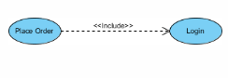
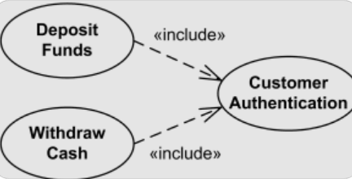
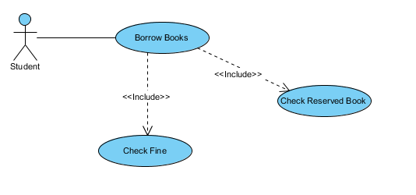

Slide 26
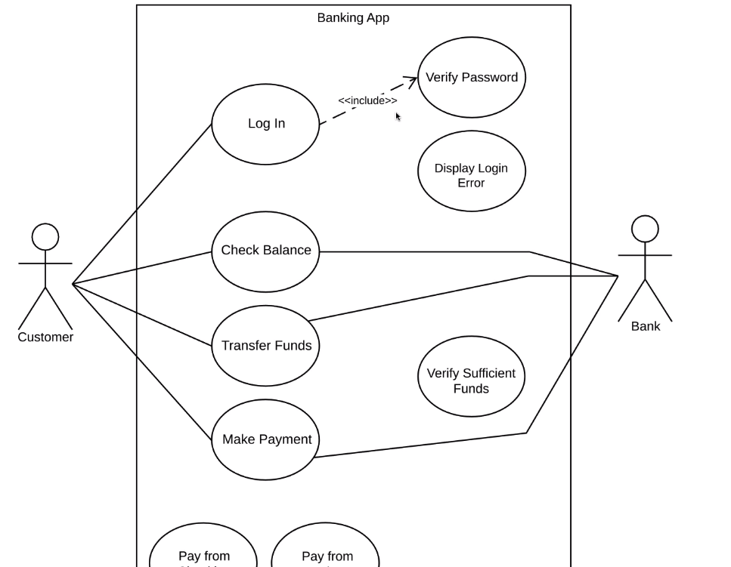

Slide 27
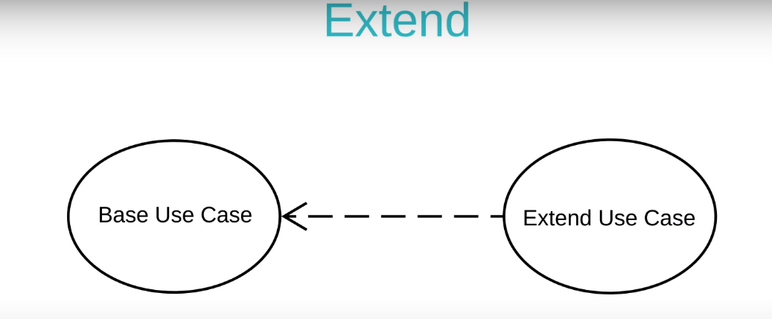
An extend relationship has a base use case and an extend use case.
When the base use case is executed, the extend use case will happen sometimes but not every time.
The extend relationships are important because they show optional functionality or system behavior.
The extend use case will only happen if certain criteria are met.

Slide 28
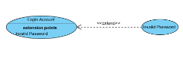
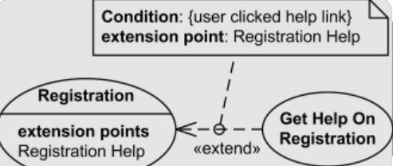
Extends adds functionality usually for abnormal case

Slide 29
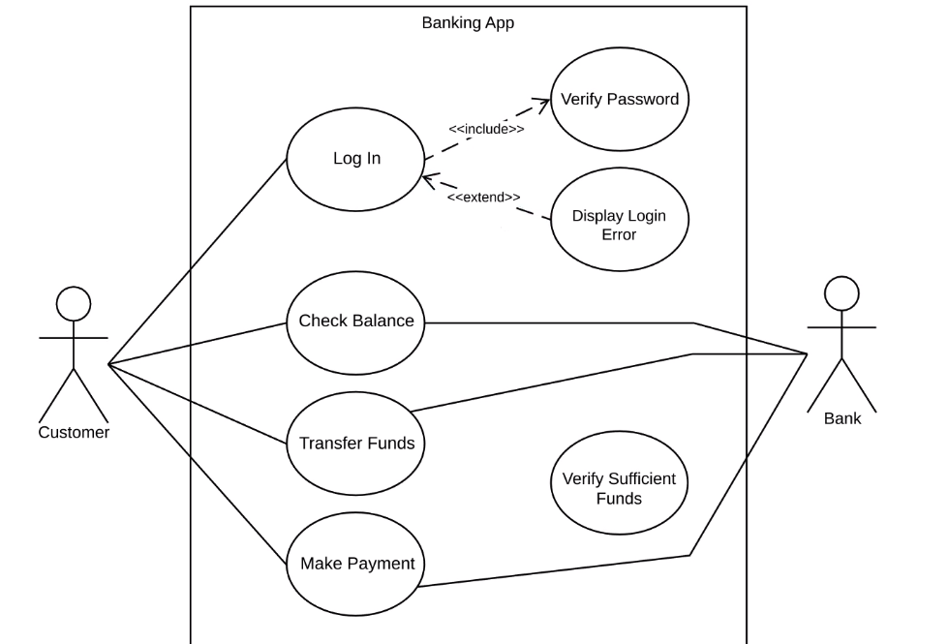

Slide 30
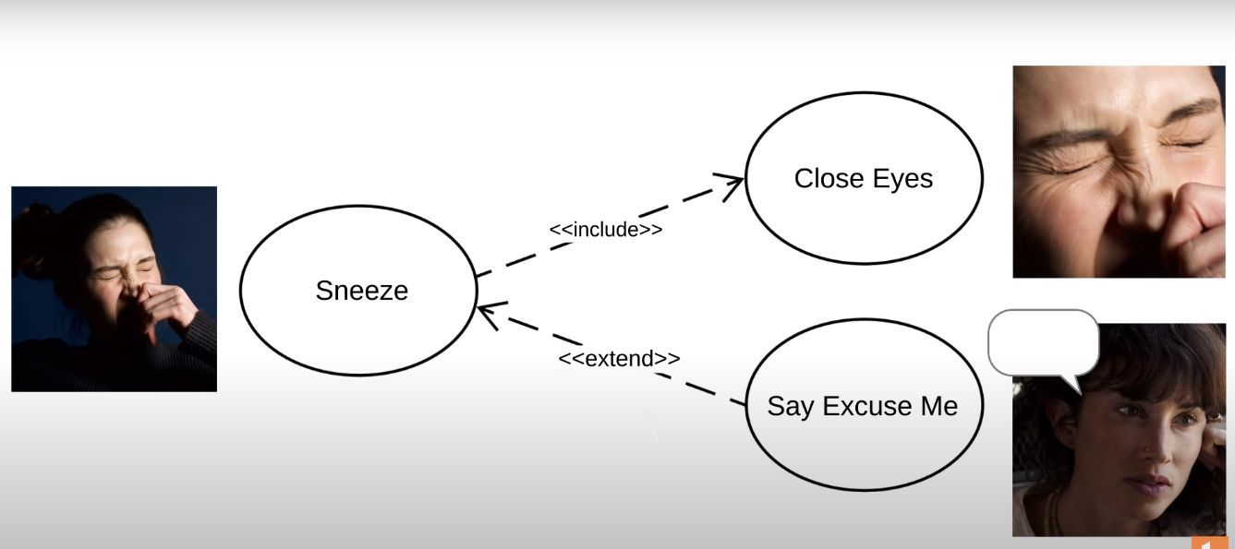
Just remember that include happens every time, extend happens just sometimes,

Slide 31
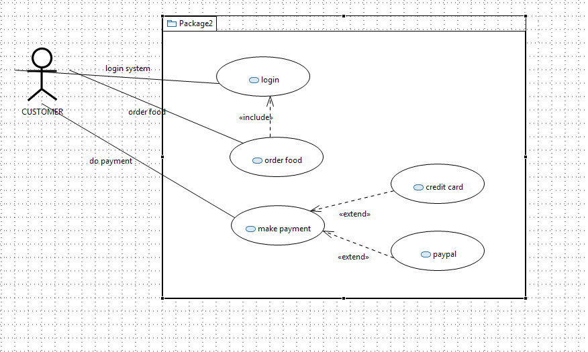

Slide 32
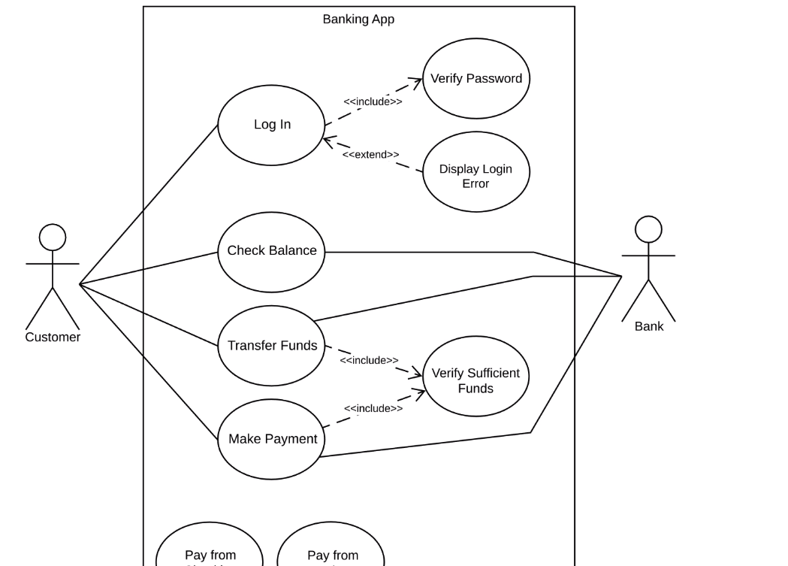

Slide 33
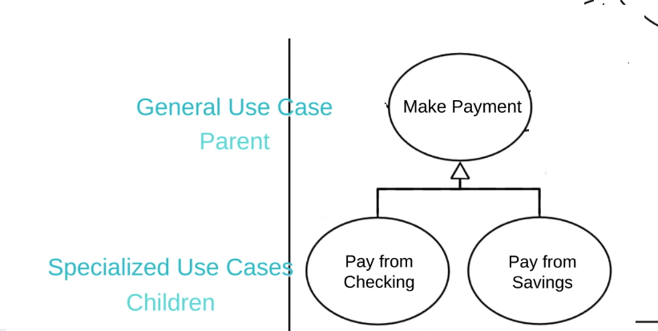
Generalization
One element (child) "is based on" another element (parent)

Slide 34
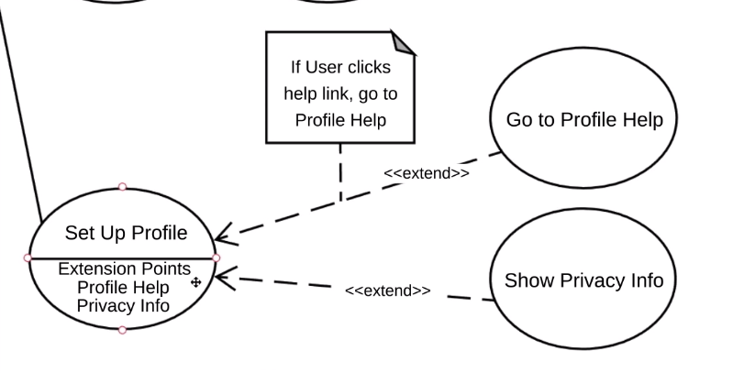
Extension Points
Extension points are just a detailed version of extend relationships.

Slide 35
Task
Draw a use case for a University website having actors student, teacher and administration. Add all types of relationships

Slide 36
Scenario
Draw a use case for Hospital Receptionist
Hospital Reception subsystem or module supports some of the many job duties of hospital receptionist. Receptionist schedules patient's appointments and admission to the hospital, collects information from patient upon patient's arrival and/or by phone. For the patient that will stay in the hospital ("inpatient") she or he should have a bed allotted in a ward. Receptionists might also receive patient's payments, record them in a database and provide receipts, file insurance claims and medical reports.

